Slide 1
Linguistics 200, Day 13
Language History; Writing Systems

Slide 2
Today
Overview of history questions in component 4
Fundamentals of writing systems

Slide 3
All languages have a history – discuss with your neighbors
How old is English?
Where does English come from?
More broadly, where does language come from?

Slide 4
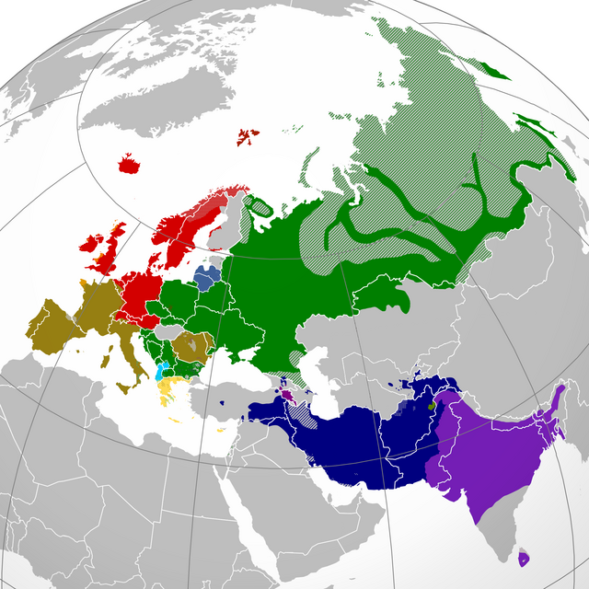
Proto-Indo-European (PIE)
Indo-European (IE) languages

Slide 5
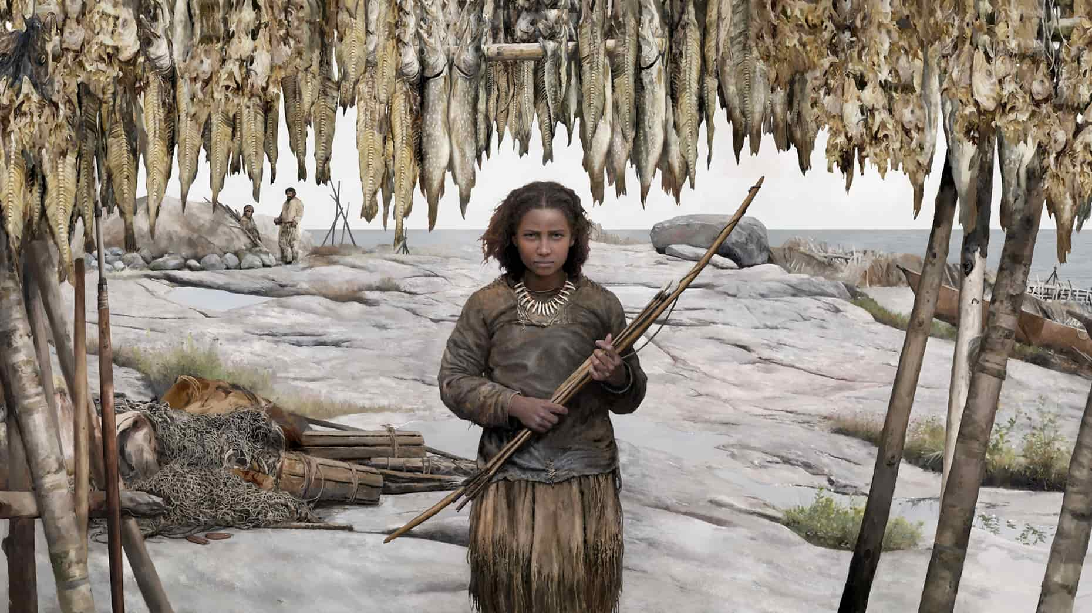
What did PIE sound like?
https://www.espoo.fi/en/events/espooevents:af7mlp3mre

Slide 6
What did PIE sound like?
I remember him,
The undefeated Thunderer,
He who defeats enemies,
He whom the Broad Earth bore,
He killed the Serpent!
A son was born from Father Sky and the Broad Earth.
Thunderer, by name.
He drinks mead with the immortal gods.
He has protected men and livestock, the two-footed and the four-footed,
He killed the Serpent!
A serpent was born in the water, in the depths, in the darkness.
At first, the Serpent overcame the Thunderer and the Immortal gods.
He killed men and livestock, the two-footed and the four-footed.
The Thunderer escaped and received the hammer from the Fashioner.
He killed the Serpent!

Slide 7

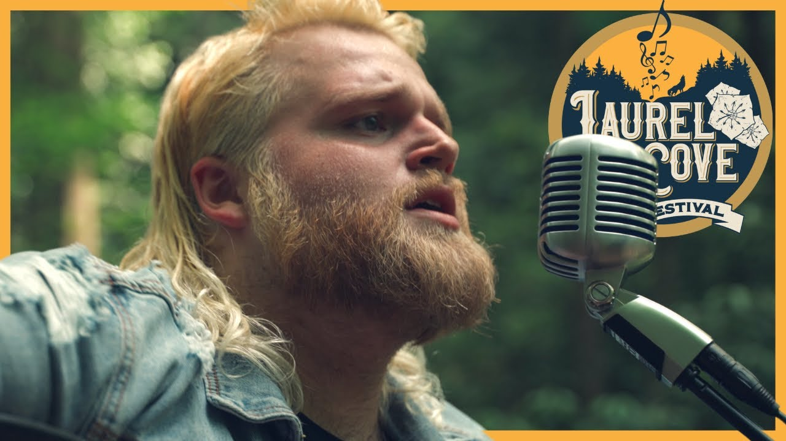
https://phillbarnett.com/
https://publires.unicatt.it/en/persons/riccardo-ginevra

Slide 8

What did PIE sound like?
Memónh₂a tóm,
N̥tr̥h₂tóm Tn̥h₂ántm̥,
H₁i̯ós ḱétrums tr̥h₂uti,
H₁i̯óm Pl̥th₂ús D^{h}éǵ^{h}ōm b^{h}eret,
H₁é g^{wh}ent h₁óg^{wh}im!
Suh₂nús Pəh₂trés Diu̯és Pl̥th₂áu̯s-k^{w}e D^{h}əǵ^{h}més ǵn̥h₁to.
Tn̥h₂ánts h₁nómn̥.
Méd^{h}u n̥mr̥tṓi̯s déi̯u̯ōi̯s pibh₃oti.
U̯íh₁roms péḱuh₂-k^{w}e pēh₂st, du̯ipédm̥s k^{w}étu̯rpedm̥s-k^{w}e pēh₂st.
H₁é g^{wh}ent h₁óg^{wh}im!
Ǵn̥h₁tó h₁óg^{wh}is udéni, b^{h}ud^{h}nói, h₁rég^{w}esu.
H₁óg^{wh}is próteros Tn̥h₂ántm̥ N̥mr̥tóms déi̯u̯oms-k^{w}e tr̥h₂ut.
H₁é g^{wh}ent u̯íh₁roms péḱuh₂-k^{w}e, du̯ipédm̥s k^{w}étu̯r̥pedm̥s-k^{w}e.
Tn̥h₂ánts b^{h}unékt u̯áǵrom-k^{w}e Tu̯r̥ḱtrés dēḱt.
H₁é g^{wh}ent h₁óg^{wh}im!
Performed by Phill Barnett

Slide 9
Let's go through this together.
Memónh₂a tóm,
N̥tr̥h₂tóm Tn̥h₂ántm̥,
H₁i̯ós ḱétrums tr̥h₂uti,
H₁i̯óm Pl̥th₂ús D^{h}éǵ^{h}ōm b^{h}eret,
H₁é g^{wh}ent h₁óg^{wh}im!
I remember him,
The undefeated Thunderer,
He who defeats enemies,
He whom the Broad Earth bore,
He killed the Serpent!

Slide 10
Suh₂nús Pəh₂trés Diu̯és Pl̥th₂áu̯s-k^{w}e D^{h}əǵ^{h}més ǵn̥h₁to.
A son was born from Father Sky and the Broad Earth.
Tn̥h₂ánts h₁nómn̥.
Thunderer, by name.
Méd^{h}u n̥mr̥tṓi̯s déi̯u̯ōi̯s pibh₃oti.
He drinks mead with the immortal gods.
U̯íh₁roms péḱuh₂-k^{w}e pēh₂st, du̯ipédm̥s k^{w}étu̯rpedm̥s-k^{w}e pēh₂st.
He has protected men and livestock, the two-footed and the four-footed,
H₁é g^{wh}ent h₁óg^{wh}im!
He killed the Serpent!

Slide 11
Ǵn̥h₁tó h₁óg^{wh}is udéni, b^{h}ud^{h}nói, h₁rég^{w}esu.
A serpent was born in the water, in the depths, in the darkness.
H₁óg^{wh}is próteros Tn̥h₂ántm̥ N̥mr̥tóms déi̯u̯oms-k^{w}e tr̥h₂ut.
At first, the Serpent overcame the Thunderer and the Immortal gods.
H₁é g^{wh}ent u̯íh₁roms péḱuh₂-k^{w}e, du̯ipédm̥s k^{w}étu̯r̥pedm̥s-k^{w}e.
He killed men and livestock, the two-footed and the four-footed.
Tn̥h₂ánts b^{h}unékt u̯áǵrom-k^{w}e Tu̯r̥ḱtrés dēḱt.
The Thunderer escaped and received the hammer from the Fashioner.
H₁é g^{wh}ent h₁óg^{wh}im!
He killed the Serpent!

Slide 12
Identifying Sound Changes
tó- ‘that one’
tn̥h₂ánt- ‘thundering’
tr̥h₂u- ‘cross’
-t (in g^{wh}ent) ‘3 sg.’
the, this, that, those, these
thun-der
through (OE þurh)
-th (giveth, taketh)
What does PIE *t generally become in English?

Slide 13
Elsewhere
tó- ‘that one’
tn̥h₂ánt- ‘thundering’
tr̥h₂u- ‘cross’
-t (in g^{wh}ent) ‘3 sg.’
is-te
tonare
trans
id est (i.e.)
What does PIE *t generally become in Latin?

Slide 14
Identifying Sound Changes
Diu̯- ‘god, Zeus’
du̯i- ‘two’
deḱ- ‘take’
u̯ed-, udén- ‘water’
Tues-day
twice, twin
MLG teche ‘order, array’
wet, water
What does PIE *d generally become in English?

Slide 15
Elsewhere
Diu̯- ‘god, Zeus’
du̯i- ‘two’
deḱ- ‘take’
u̯ed-, udén- ‘water’
deus, divus
bi-
dexter, decor, doceo, etc.
unda
What does PIE *d generally become in Latin?

Slide 16
Identifying Sound Changes
b^{h}ud^{h}nó- ‘bottom’
d^{h}eh₁- ‘put, place, do’
d^{h}u̯or- ‘door’
dʰeiǵʰ- ‘knead, build’
OE bodan ‘bottom’
do
door
dough
What does PIE *d^{h} generally become in English?

Slide 17
Elsewhere
b^{h}ud^{h}nó- ‘bottom’
d^{h}eh₁- ‘put, place, do’
d^{h}u̯or- ‘door’
dʰeiǵʰ- ‘knead, build’
fundus
facio, fact-
for-
fict-
What does PIE *d^{h} generally become in Latin?

Slide 18
These are the sorts of changes scholars identify in establishing genetic relationships between families.

Slide 19
Question 1
1. What is the history of your language? Where does it come from? What is the history of your conlang's speakers?

Slide 20
How to approach this question
What is the backstory of your culture?
How did your group of people get to where they live?
Where did they come from?
How long has it been since your group of people left where they came from?

Slide 21
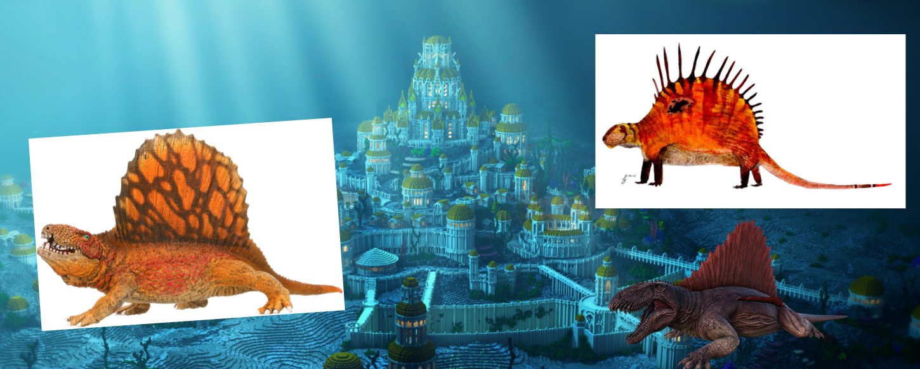
The Mɤɧøɴ are a group of underwater dinosaurs -- what backstory would you invent for them?

Slide 22
Question 2
2. Discuss one other language that your conlang is related to in detail. Describe this language's history, and the point at which your language and this second language diverged."

Slide 23
How to approach this question
Now focus on where your group of people came from
Think about their original culture
What other groups might have also originated from this culture?
What is their story?

Slide 24
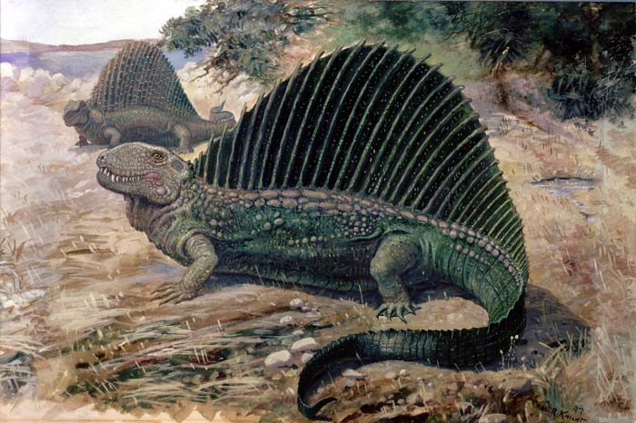

Slide 25
Today
Overview of history questions in component 4
Fundamentals of writing systems

Slide 26
Writing
What are writing systems?

Slide 27
In making your writing system, you have two tasks...
What are the symbols used in the system?
What type of writing system is it?
Today’s task -- experimenting with the look of your language’s symbols

Slide 28
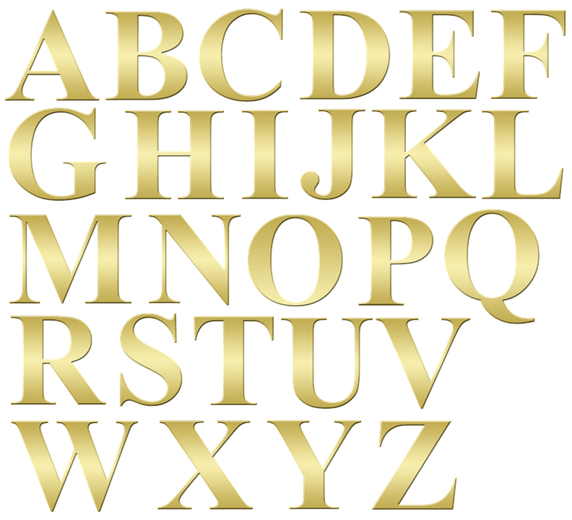
Symbols?

Slide 29
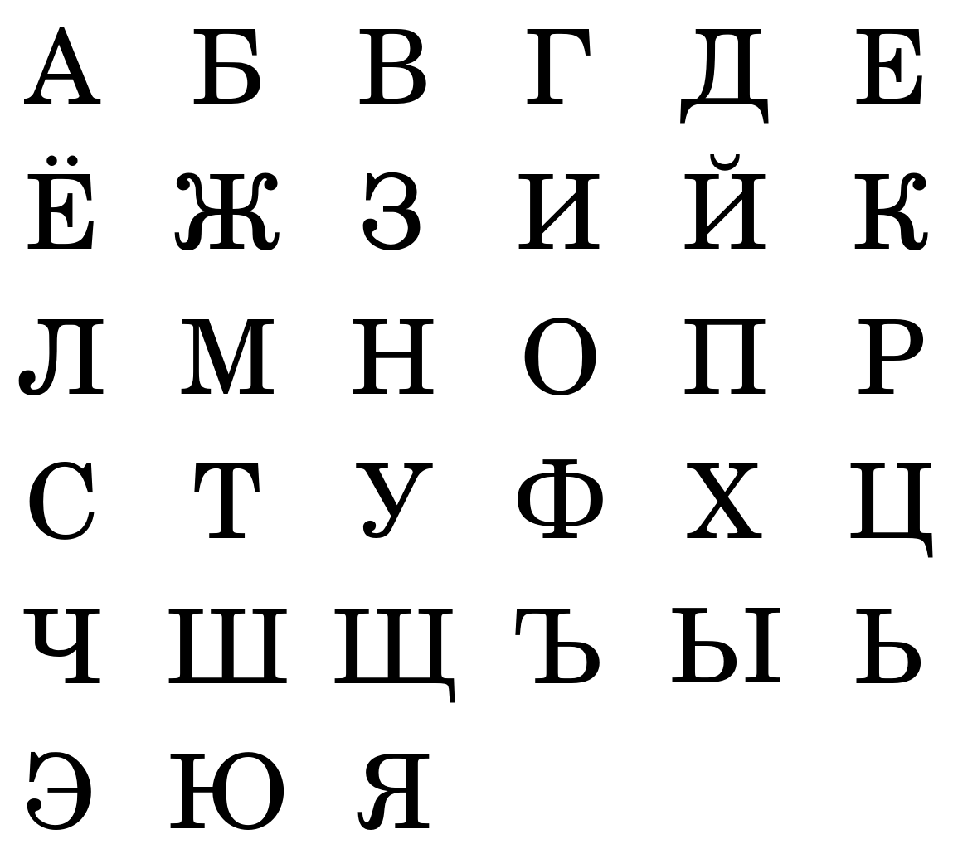
Symbols?

Slide 30
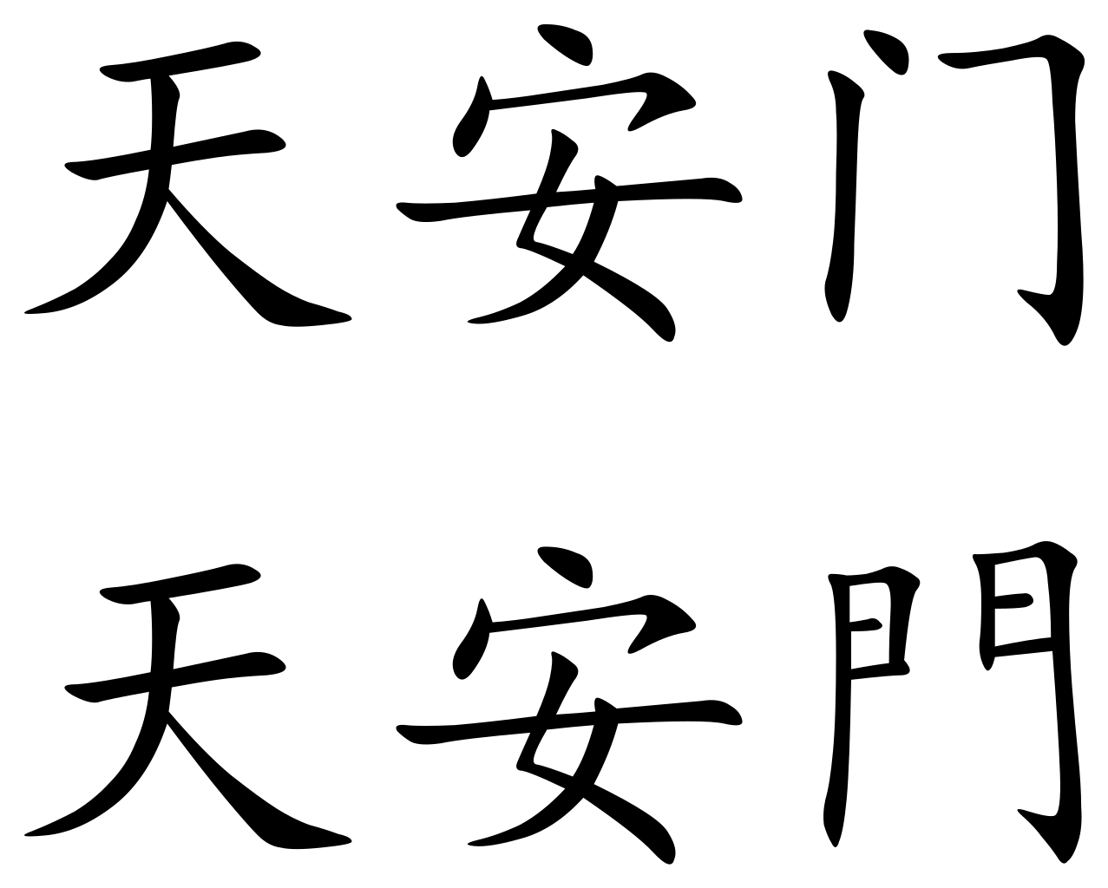
Symbols?

Slide 31
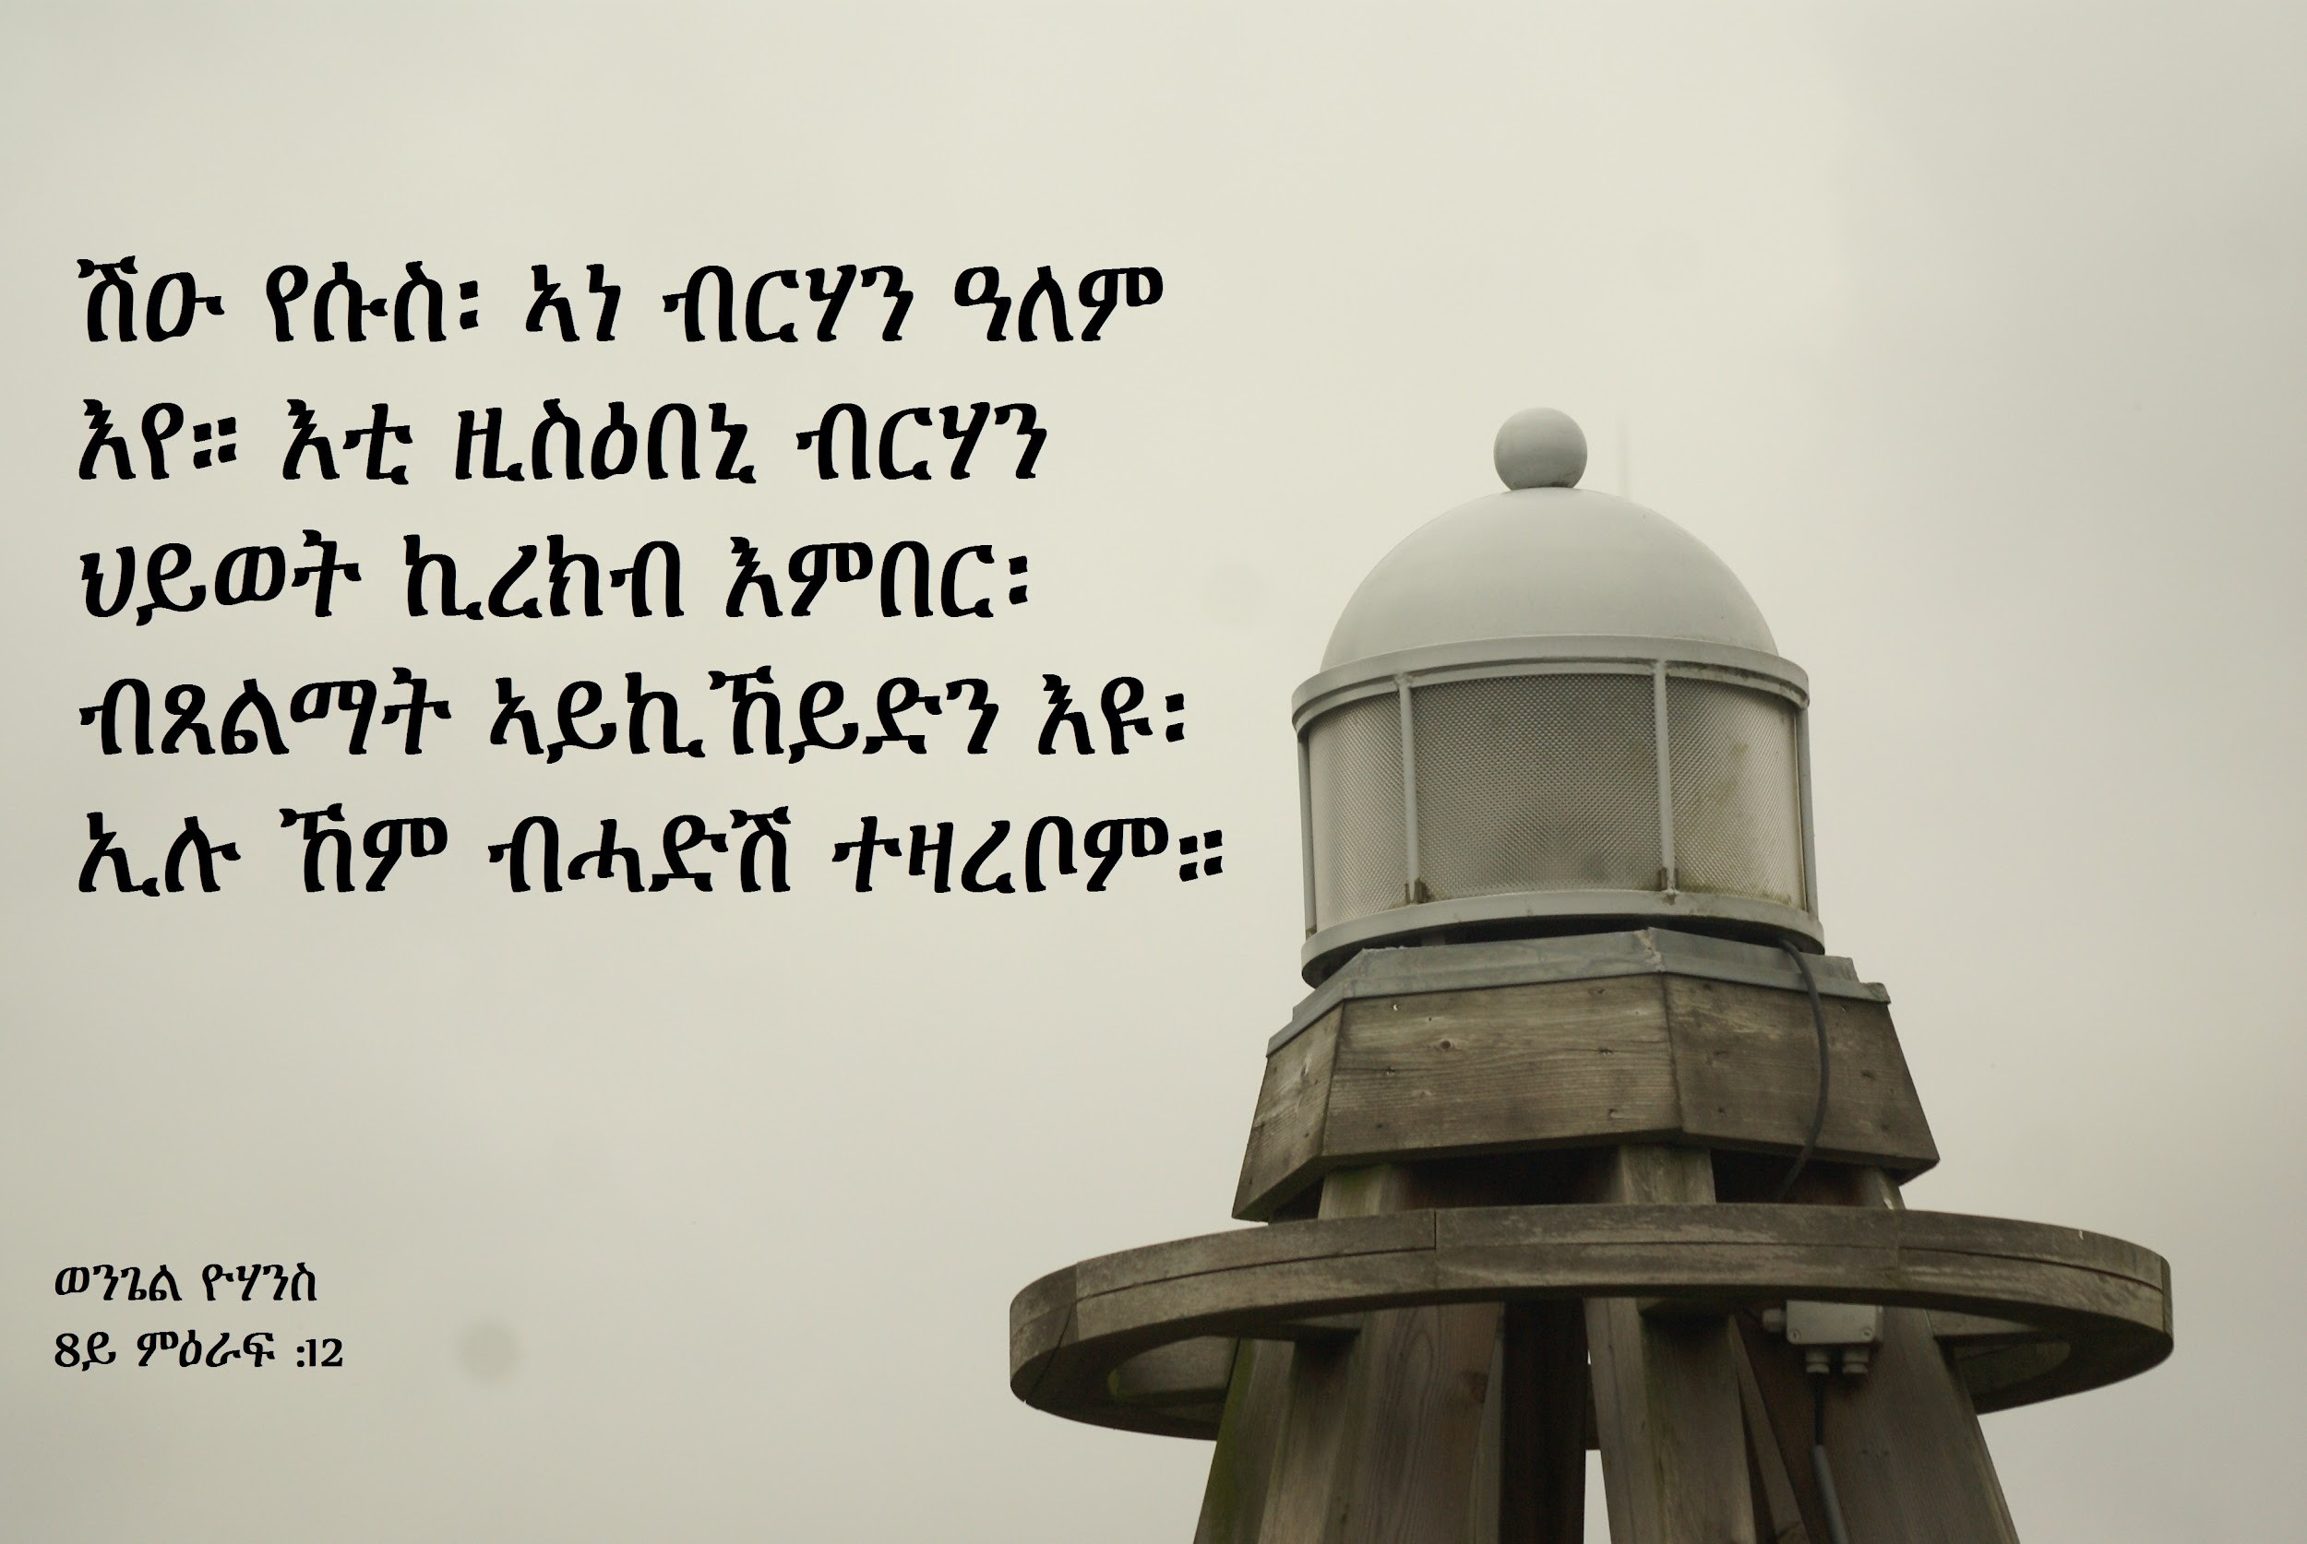
Symbols?

Slide 32
With your group
Visit https://omniglot.com/, click on each category under “Writing Systems”: “alphabets”, “abjads”, “abugidas”, etc.
Choose three writing systems that you like the look of
Think:
What about these writing systems appeals to you?
Are the characters angular? Circular?
Do the characters run together or are they separate (i.e. curvise vs. block)?
When your group of people write things down, what are they writing on?
Mɤɧøn -- underwater rock carvings

Slide 33
Next task - Let’s sketch 5 symbols
https://sketch.io/sketchpad/

Slide 34
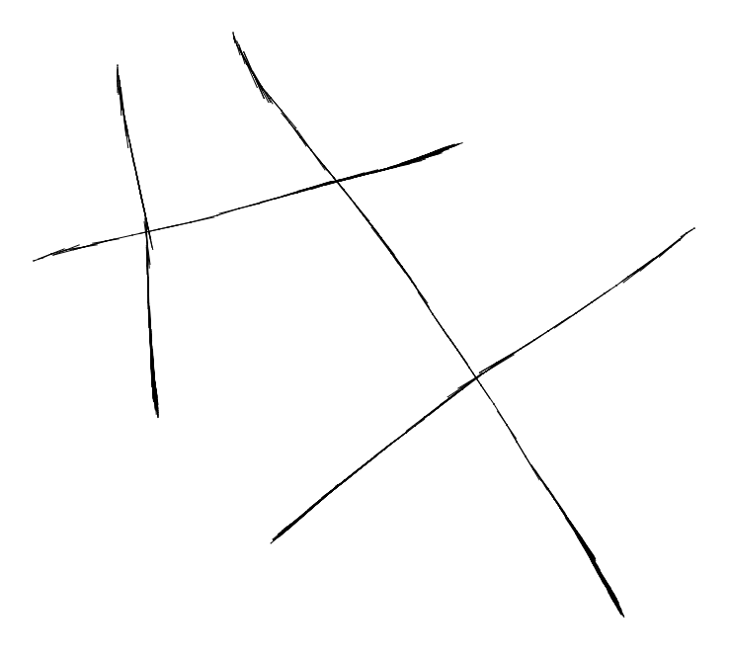
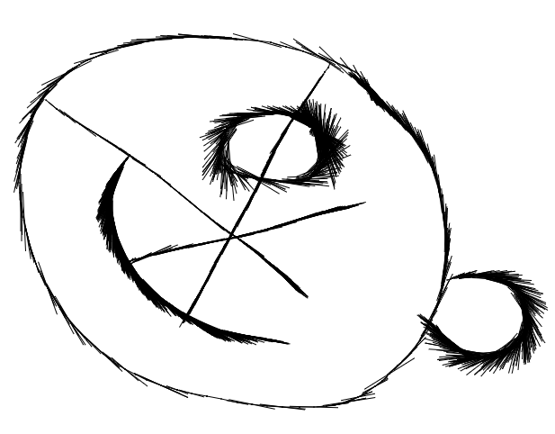
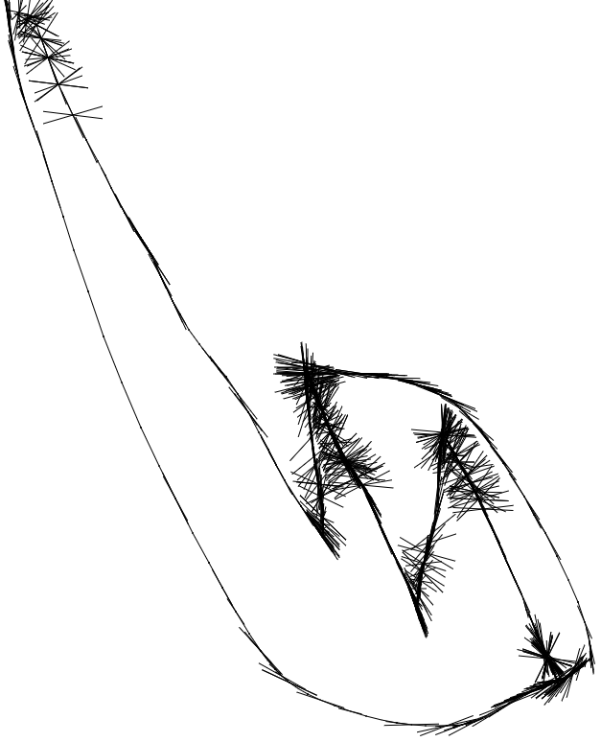
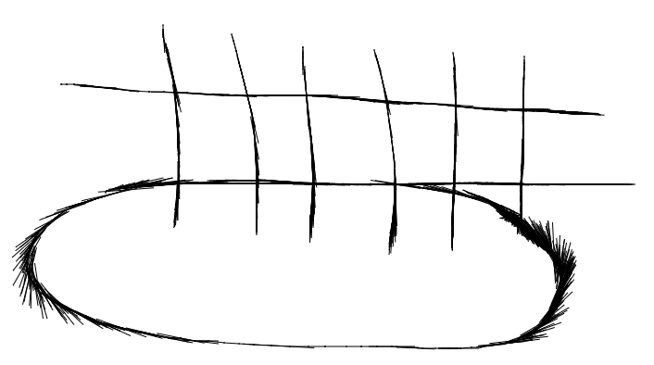
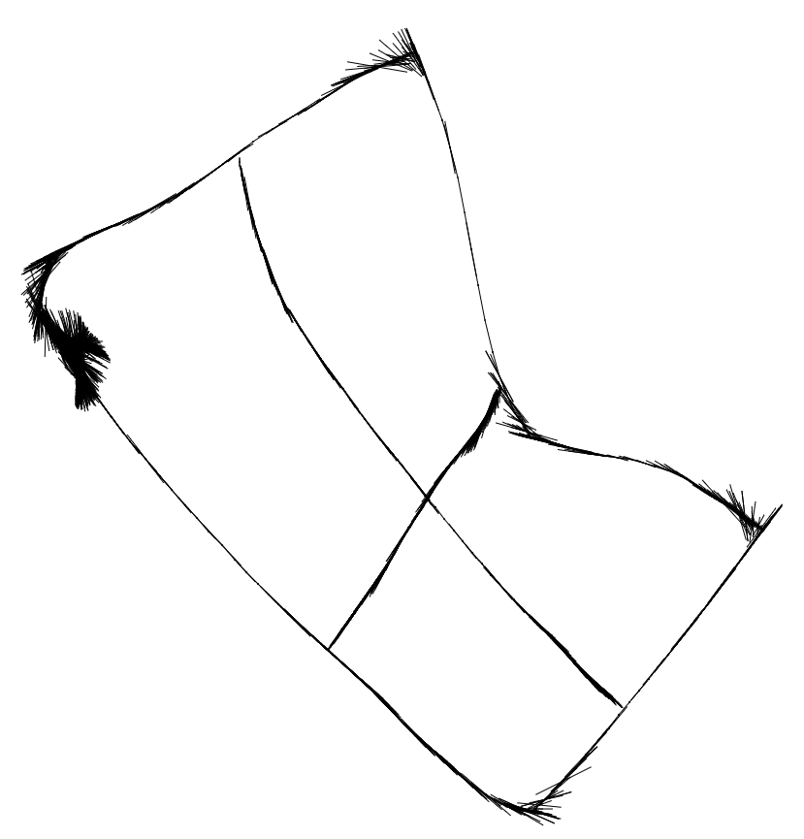
Alex’s Creations

Slide 35
Linguistics 200, Day 13
Language History; Writing Systems

Slide 36
Review
History:
Where does your group come from?
What is a related group?
Writing Systems
What are they?
Five symbols!

Slide 37
Last time: 5 symbols

Slide 38
Next task - Let’s sketch 5 more symbols
https://sketch.io/sketchpad/

Slide 39
Let’s begin by attributing a function to those symbols...
When making a writing system, you have to decide:
Do the symbols represent sounds? (phonographic)
Do they represent meaning? (logographic)
Or are they part of a hybrid system?

Slide 40
Today: Writing Systems that Represent Sounds
Symbols represent sound segments
Alphabet
Abjad
Abugida / Alphasyllabary
Symbols represent syllables
Syllabary

Slide 41
Syllabaries
Each symbol represents a unique syllable in the language
<If> <Eng><lish> <had> <a> <syl><la><ba><ry> <we> <would> <write> <like> <this>

Slide 42
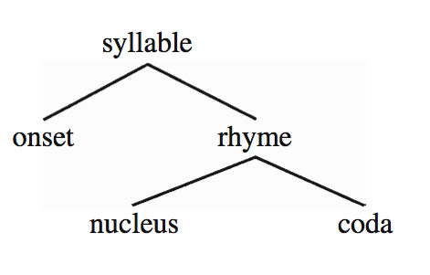
Syllables
C V C
c a t
d o g

Slide 43
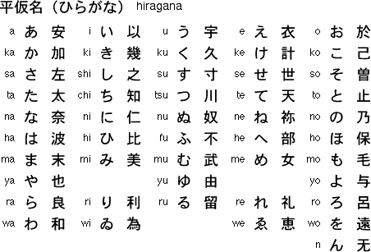
Japanese Hiragana

Slide 44
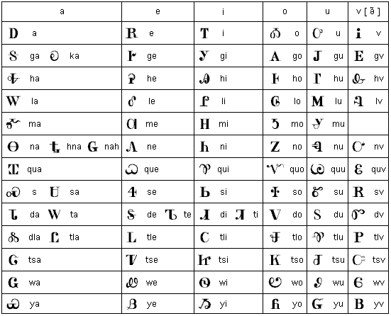
Cherokee Syllabary

Slide 45
さす
のき
あした
うら

Slide 46
English as a Syllabary?
Is English a good candidate for using a syllabary?
Onsets (1, 25) + (2, ~42) + (3 x ~ 9) = 76
Nuclei – 18 (14 vowels + syllabic liquids, nasals)
Codas – ~100
18 + (76 x 18) + (100 x 18) + (76 x 18 x 100) = 139,986!!!!!

Slide 47
Syllabaries
Many of the world’s languages that utilize syllabaries have very restrictive syllable structure
Syllables look like CVCVCVCVCV
CV = consonant + vowel
cf. Hawaiian meli kalikamaka ‘Merry Christmas’
cf. Japanese meri kurisumasu ‘Merry Christmas’
In a syllabary, each grapheme should represent a syllable
And what does every syllable have?
A nucleus! (usually a vowel, V)
So each grapheme – at the bare minimum – should represent a nucleus

Slide 48
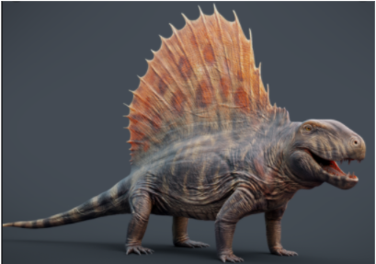
Should Mɤɧøɴ have a syllabary?

Slide 49
 | Bilabial | Alveolar | Retroflex | Palatal | Velar | Uvular
Stop voiceless implosive | p ɓ | t ɗ |  |  | k ɠ | q ʛ
Nasal | m | n |  |  | ŋ | ɴ
Fricative voiceless voiced |  | s |  | ç | x ɧ ɣ
Glide | w |  |  | j
Liquid |  |  | ɭ |  |  | ʀ

Slide 50
 | Front | Central | Back
High | i |  | u
Mid | e ø |  | ɤ o
Low |  | a

Slide 51
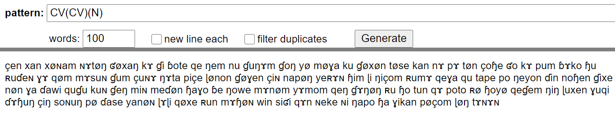
What’s really important: Phonotactics

Slide 52
So… syllables are either CV or CVN
This means:
pi pe pø pa pɤ po pu
pim pem pøm pam pɤm pom pum
pin pen pøn pan pɤn pon pun
piŋ peŋ pøŋ paŋ pɤŋ poŋ puŋ
piɴ peɴ pøɴ paɴ pɤɴ poɴ puɴ
7 x 5 = 35 symbols
21 consonants
35 x 21 = 735 symbols!!!!

Slide 53
Japanese Hiragana has a “Cheat”

Slide 54
Cherokee Syllabary also has a “Cheat”

Slide 55
Creating a “Cheat” for Mɤɧøɴ
This means:
pi pe pø pa pɤ po pu
m
n
ŋ
ɴ
11 symbols
21 consonants
7 vowels
7 x 21 = 147 + 7 + 4 = 158 symbols

Slide 56
Should Dorgon have a syllabary?
Behold! I am Galasiul. I am the greatest of all (the) Dorgons.
unb! sa galasjul pfode. sa gpfapfa ekesxdg-aŋk-on pfode.
As emperor, all Dorgons bow at my feet.
ikacoɳɟa, kθu ekebase sxdo ekepfodg-aŋk-on.
(The) Killer Dorgons lay their weapons at my feet.
modlx-ekexon-a ekesxa ekebase sxdo.

Slide 57
Should your language have a syllabary?

Slide 58
Next task - Let’s sketch 5 more symbols
https://sketch.io/sketchpad/

Slide 59
Linguistics 200, Day 13
Language History; Writing Systems

Slide 60
Review
What are writing systems?
Types of writing systems: phono-, logo-
Syllabaries

Slide 61
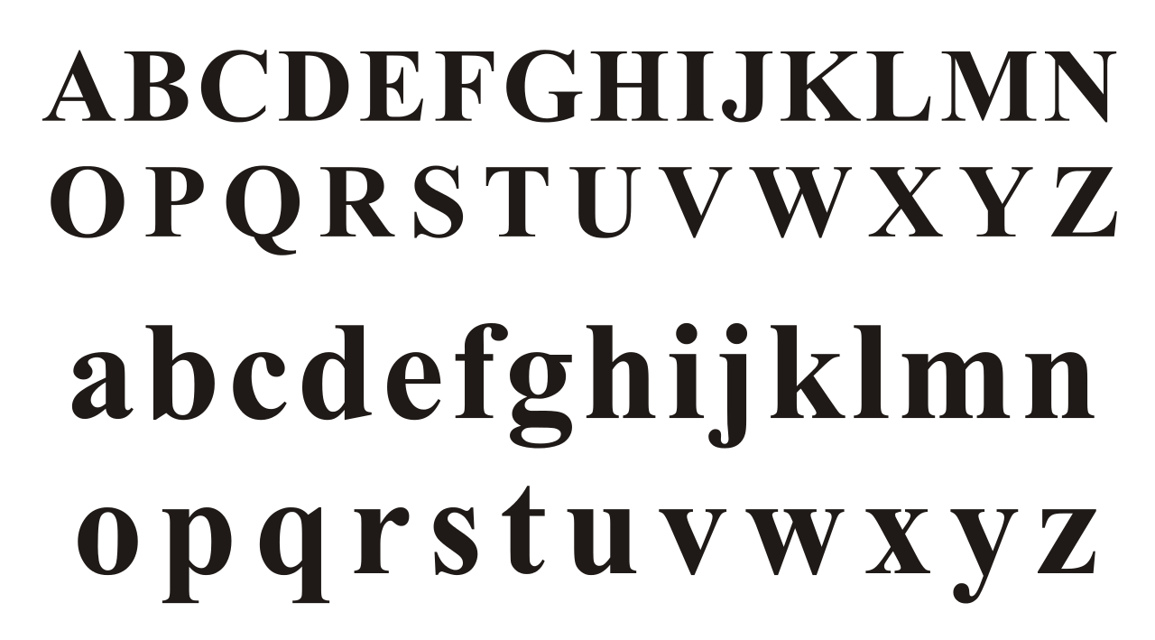
Segmental Writing Systems

Slide 62
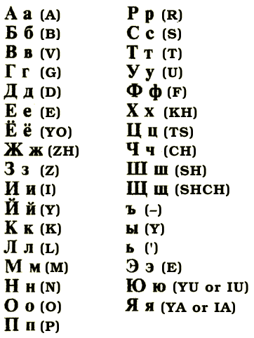

Slide 63
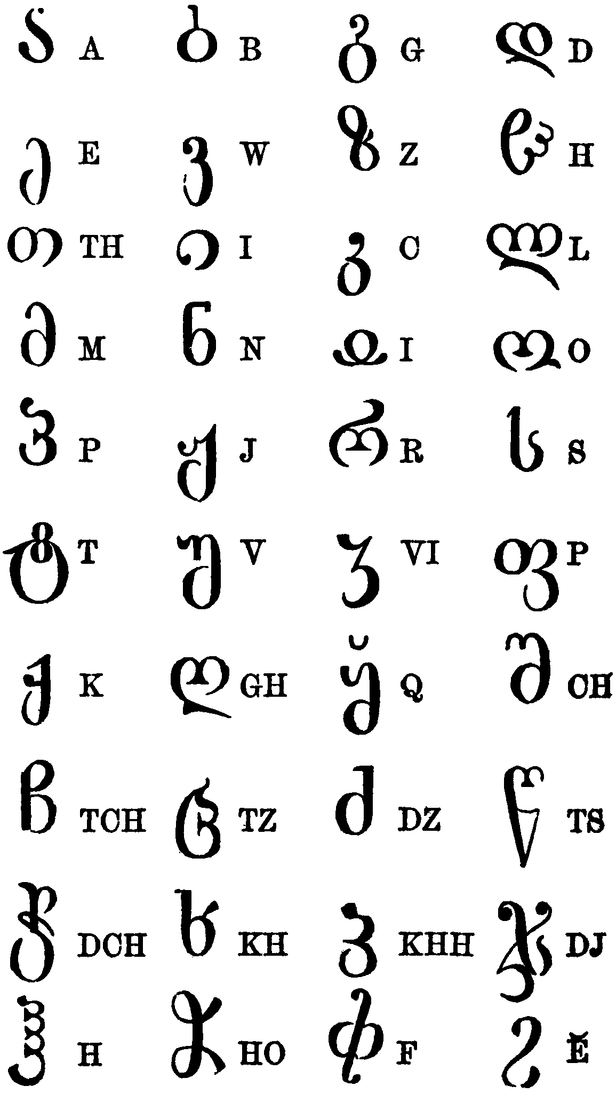

Slide 64
Alphabet
Has symbols for both consonants and vowels
May contain:
Digraphs -- two letters = 1 sound
sh, th, ch
One letter = 2 sounds
x

Slide 65
Should Mɤɧøɴ have an alphabet?

Slide 66
What it could look like:
< a >
< p >
< t >
< e >
< k >

Slide 67
Should Mɤɧøɴ have an alphabet?
Yes:
There are both consonants and vowels in the language
It’s super easy
No:
It’s super boring

Slide 68
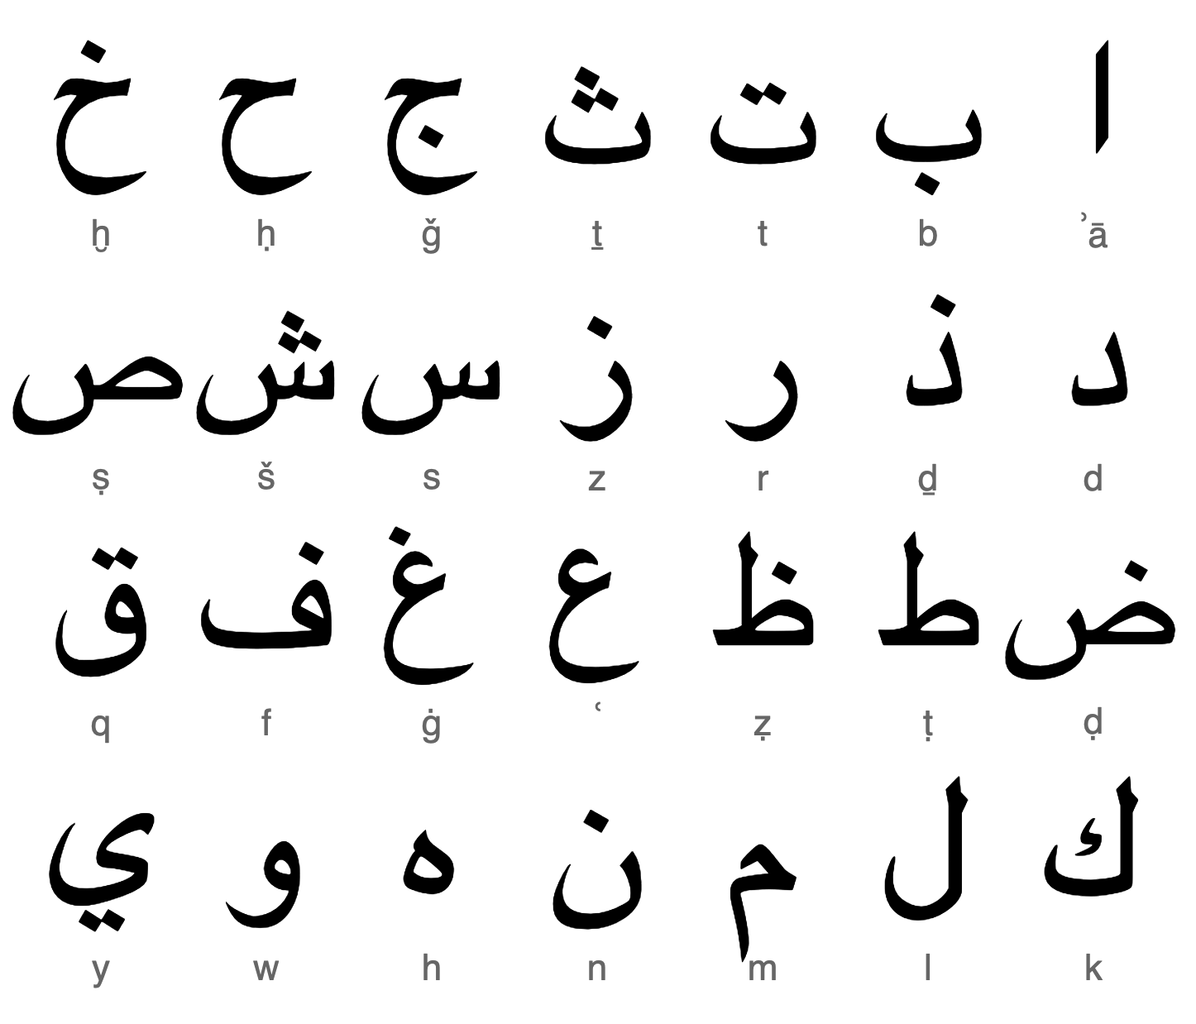
ʔ

Slide 69
Abjad
Only has symbols for consonants

Slide 70
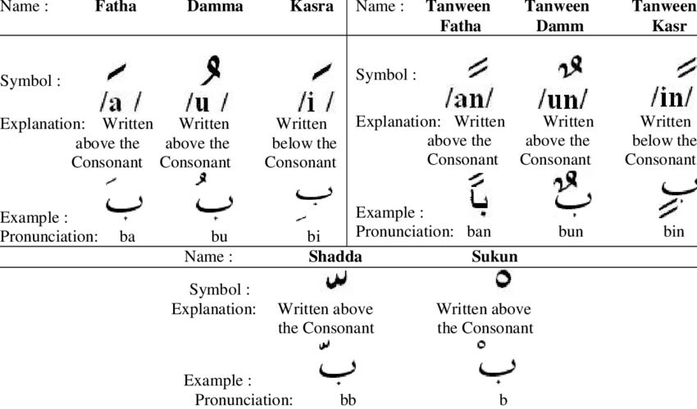

Slide 71
Should you have an abjad?
Cn y’ll rd ths sntnc? Ths s wht nglsh wld lk lk f th lphbt wr n bjd.

Slide 72
Should your language have an abjad?
Are the vowels predictable through context?
If yes, then absolutely.
If no, then no.

Slide 73
Should your language have an abjad?
Are the vowels predictable through context?
If yes, then absolutely.
If no, then no.
Yesterday, I sng a sng.

Slide 74
Should your language have an abjad?
Are the vowels predictable through context?
If yes, then absolutely.
If no, then no.
At noon I sng a sng.

Slide 75
Should your language have an abjad?
Are the vowels predictable through context?
If yes, then absolutely.
If no, then no.
T nn sng sng.

Slide 76
Should Mɤɧøɴ have an abjad?

Slide 77
What it could look like:
< q >
< p >
< t >
< m >
< k >

Slide 78
Should Mɤɧøɴ have an abjad?
Let’s take a look at a line that was translated:
Çi ɗekampaa ʀiɴɤ Wisiyesi. → Ç ɗkmp ʀɴ Wsys.
“Once upon a time, there was a city named Undersplash.”
pa ‘past’ vs. paa ‘super past’
çi ‘progressive’ vs. çɤ ‘could’

Slide 79
Should Dorgon have an abjad?
Behold! I am Galasiul. I am the greatest of all (the) Dorgons.
unb! sa galasjul pfode. sa gpfapfa ekesxdg-aŋk-on pfode.
As emperor, all Dorgons bow at my feet.
ikacoɳɟa, kθu ekebase sxdo ekepfodg-aŋk-on.
(The) Killer Dorgons lay their weapons at my feet.
modlx-ekexon-a ekesxa ekebase sxdo.

Slide 80
Should your language have an abjad?

Slide 81
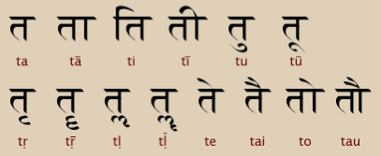
Devanagari (Sanskrit, Hindi)

Slide 82


Ge’ez (Amharic, Tigrinya)

Slide 83
Abugida (Alphasyllabary)
Kind of like an abjad, in that the consonant symbols are the focus
But is an alphabet, in that it has symbols for both consonants and vowels
Arranged by syllables, with vowels usually marked by “diacritics” (extra squiggles, lines, etc.)

Slide 84
Should Mɤɧøɴ have an abugida?

Slide 85
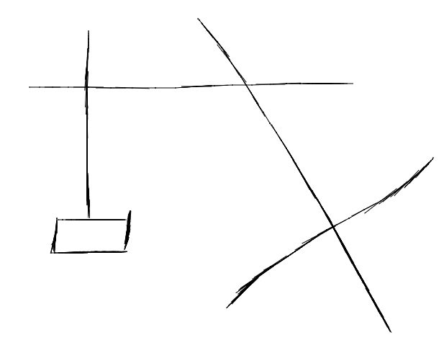
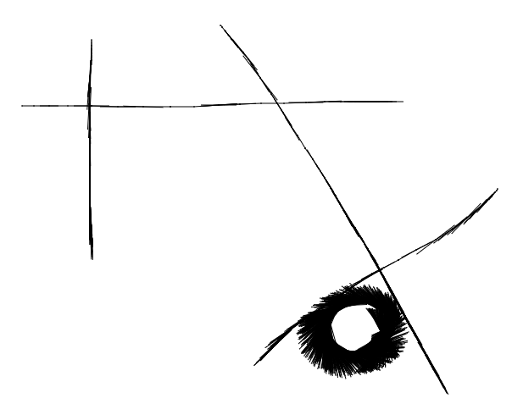
What it could look like:
< pɤ > (no modification - most common vowel in language)
< pi > <pa> <qa>

Slide 86
Should Mɤɧøɴ have an abugida?
Yes:
There are both consonants and vowels in the language
It’s super easy and cool
No:
Nada!

Slide 87
Activity: which system works best?
Pick a single consonant in your language from your consonant inventories.
Next, write down all of the vowels in your vowel system. (If your language is tonal, don’t forget about tones!)
Finally, identify your phonotactics -- how many syllable combinations would your language have?
5-10?
Or a TON?

Slide 88
If there's time: Let’s sketch 5 more symbols
https://sketch.io/sketchpad/

